Slide 1
SPOTIFY DATA ANALYSIS.
Project by Dauda Agbonoga

Slide 2
Aim of project
This project aims to Identify trends, patterns and also help artistes identify areas more appealing to their fanbase.

Slide 3
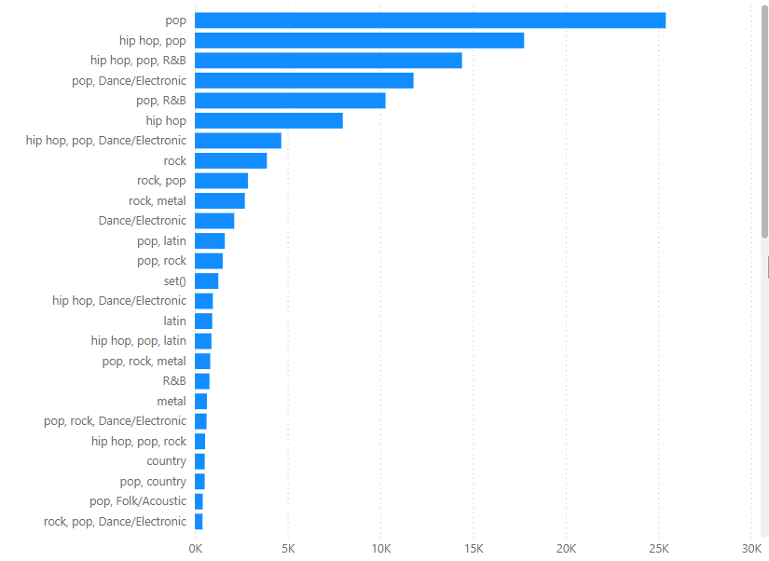
THIS CHART SHOWS THE popularity of different genres of songs between the year 2000-2020.

Slide 4
This we can deduce that;
More songs that do well tend to be explicit (52%)
Explicit songs that do well tend to have higher average tempo.
Less explicit songs tend to have more popularity.
Less explicit songs tend to be more lively

Slide 5
In here we have the top 5 genres and their average tempo which is measured in beats per minute:
1. Pop tracks appears to be the fastest with an average tempo of 122 BPM 2. Hip-hop, pop, R&B with an average of 115 BPM 3. Pop, R&B with an average of 114 BPM 4. Hip-hop, Pop with an average of 113 BPM 5. Hip-hop with the least having an average of 112 BPM

Slide 6
In here we have the most streamed artiste from the year 2000-2024

Slide 7
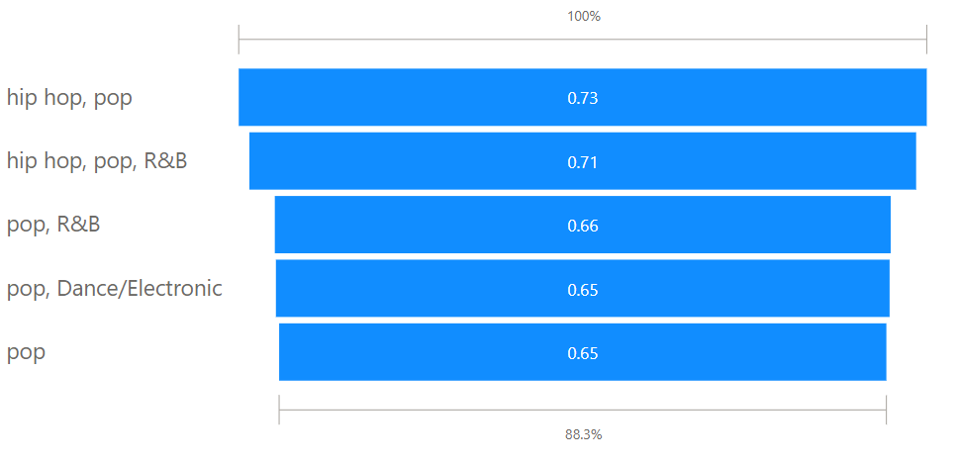
This shows the average danceability of the top 5 genres in terms of its popularity

Slide 8
THANK YOU!

